Slide 1
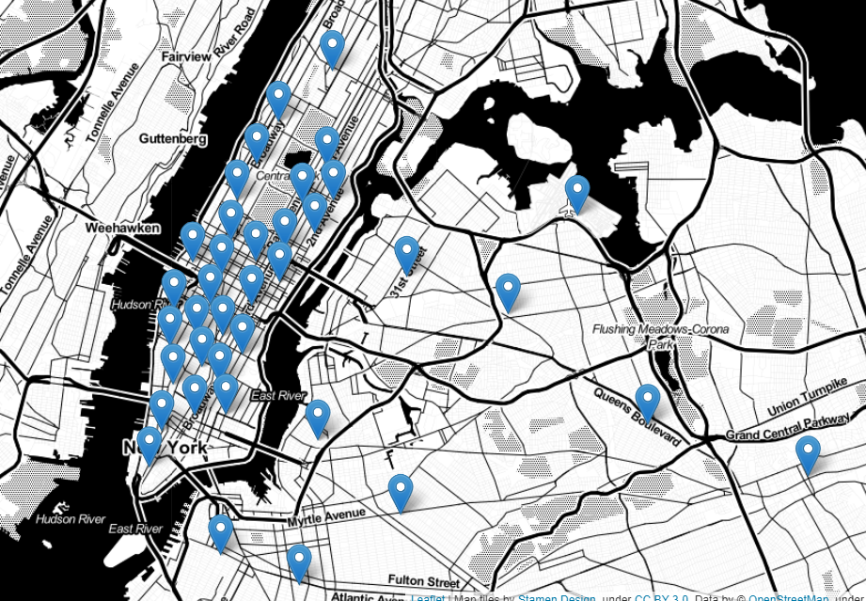
Taxi Demand Prediction
By Eddie Amaitum

Slide 2


Demand in taxi/car share industry
Drivers(Supply) Vs Customers(Demand)
Companies need to forecast demand

Slide 3


Solution: Predict taxi demand per hour by location
Ops team can adjust the distribution of drivers
Operations team
$ 3 for pick-ups around the arena

Slide 4
Impact
Predictive models shown to cut wait times by up to 20%
Improved efficiency in driver deployment hence companies generate more revenue
Increased customer satisfaction

Slide 5
Dataset
NYC Taxi & Limousine Commission (TLC) Trip Records
The data is relatively clean
Feature engineering needed

Slide 6
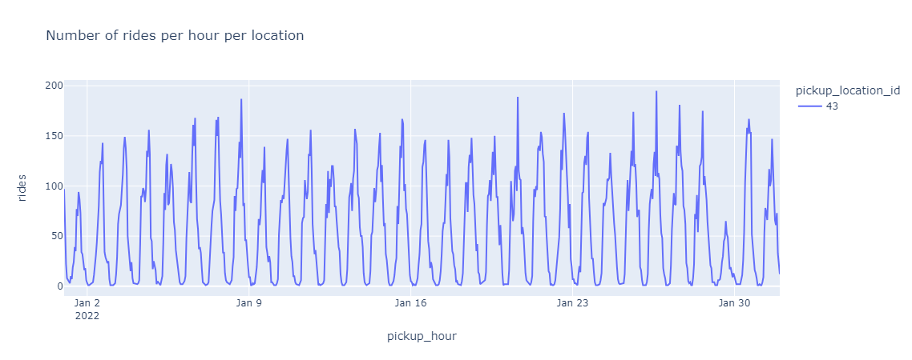
Sample Time Series Data

Slide 7
Data transformation into (features, targets)
Raw data
Filter data
Validated data
Aggregate data
Time-Series data
Slice data
Features, targets for modelling

Slide 8
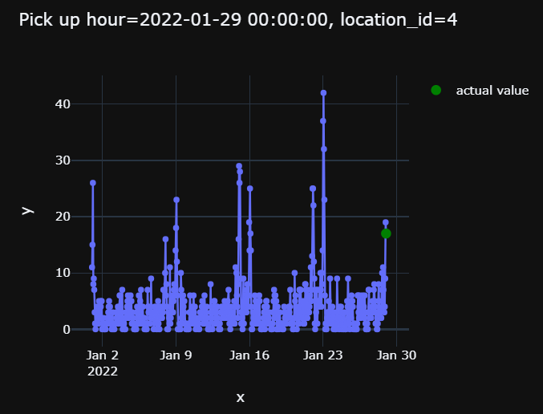
Sample features , target variables

Slide 9
Split the data
Train data
Tabular data with features and target
Data preparation
Split by date e.g Aug
Test data

Slide 10
Baseline models
Baseline model 1
NoML
Baseline model 2
NoML
Baseline model 3
NoML
Train data
Tabular data with features and target
Test data
MAE 1 = 6.05
MAE 2 = 3.68
MAE 3 = 3.19

Slide 11
Model comparison
Model | Mean Absolute Error (MAE) | Notes
Ad Hoc model 1 | 6.05 | Baseline model
Ad Hoc model 2 | 3.68 | Baseline model
Ad Hoc model 3 | 3.19 | Baseline model
XGBoost | 2.70 | Models improved
Lightgbm | 2.57 | Models improved
Lightgbm + feature engineering | 2.59 | Added average rides per month
Lightgbm + hyperparameter tuning | 2.54(num_leaves,min_child_samples,etc) | Best model for production

Slide 12

Further improve model performance by adding more features
Build pipelines to automate processes
Complete model operationalization

Slide 13
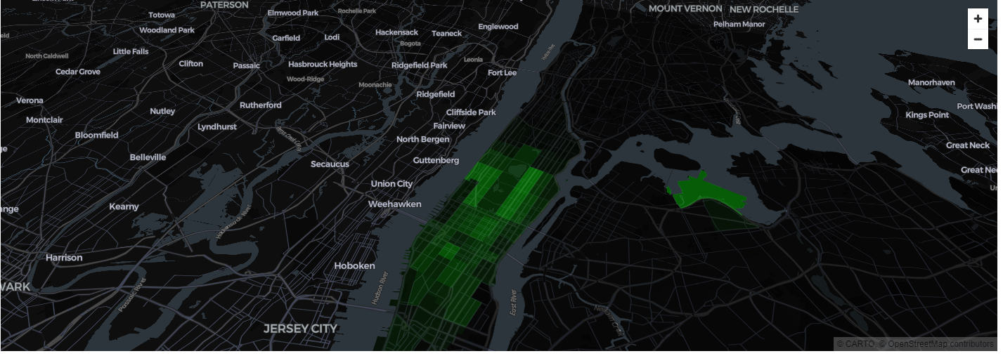
Sample streamlit UI dashboard

Slide 14


